Slide 1
First Glimpse at Medicare 2011 Hospice Utilization 11/3/13
Hospice Analytics
www.HospiceAnalytics.com

Slide 2
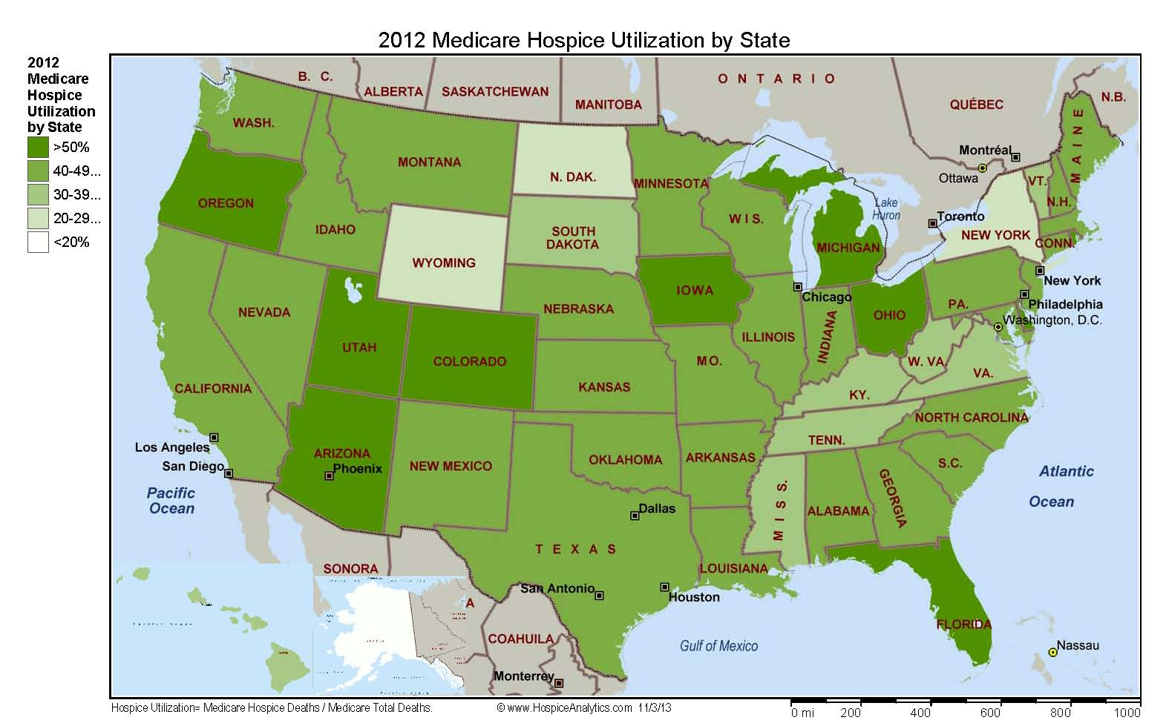

Slide 3
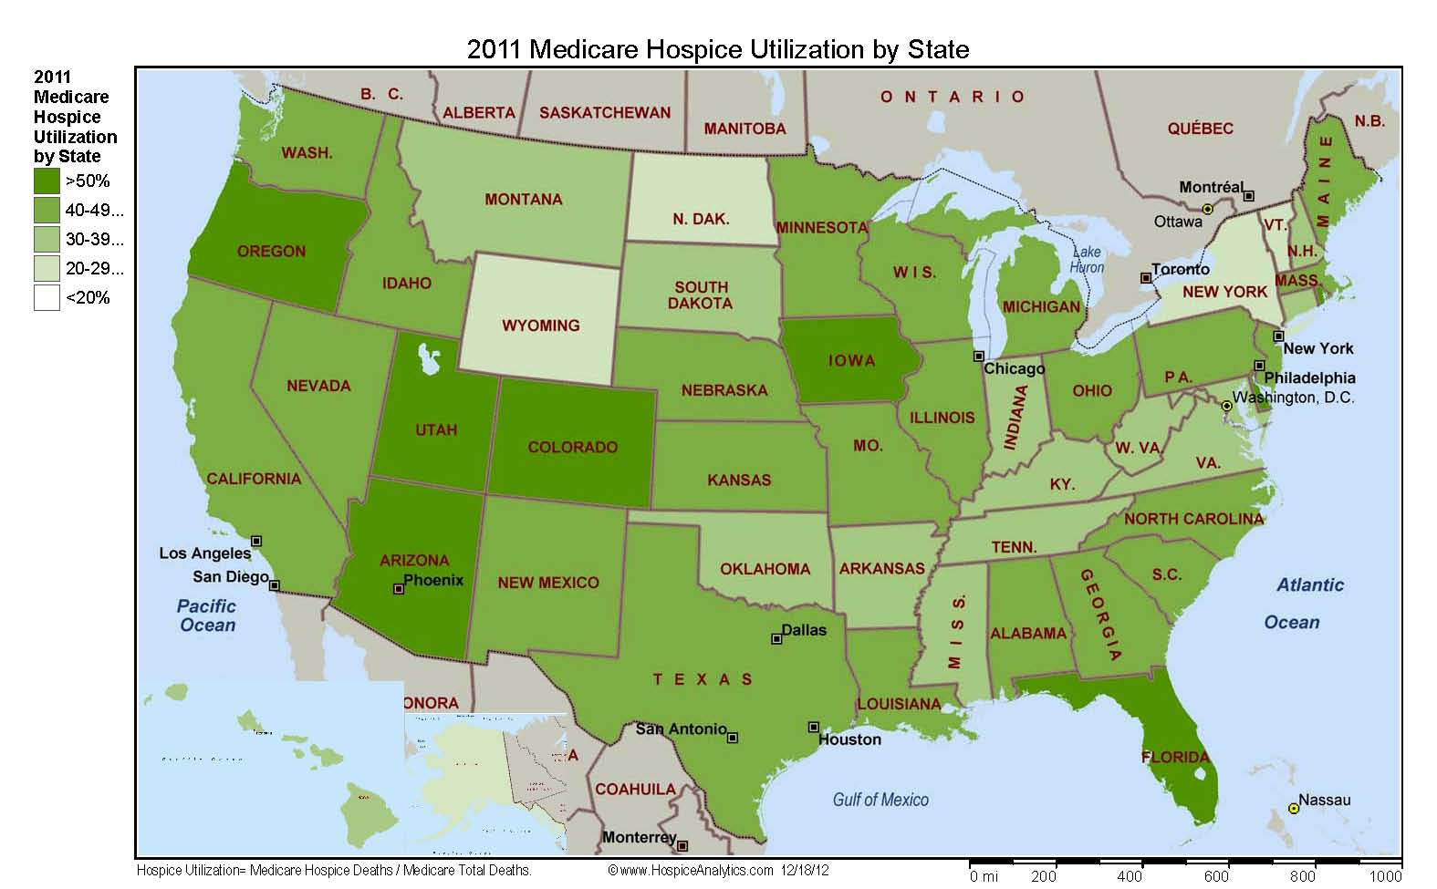

Slide 4
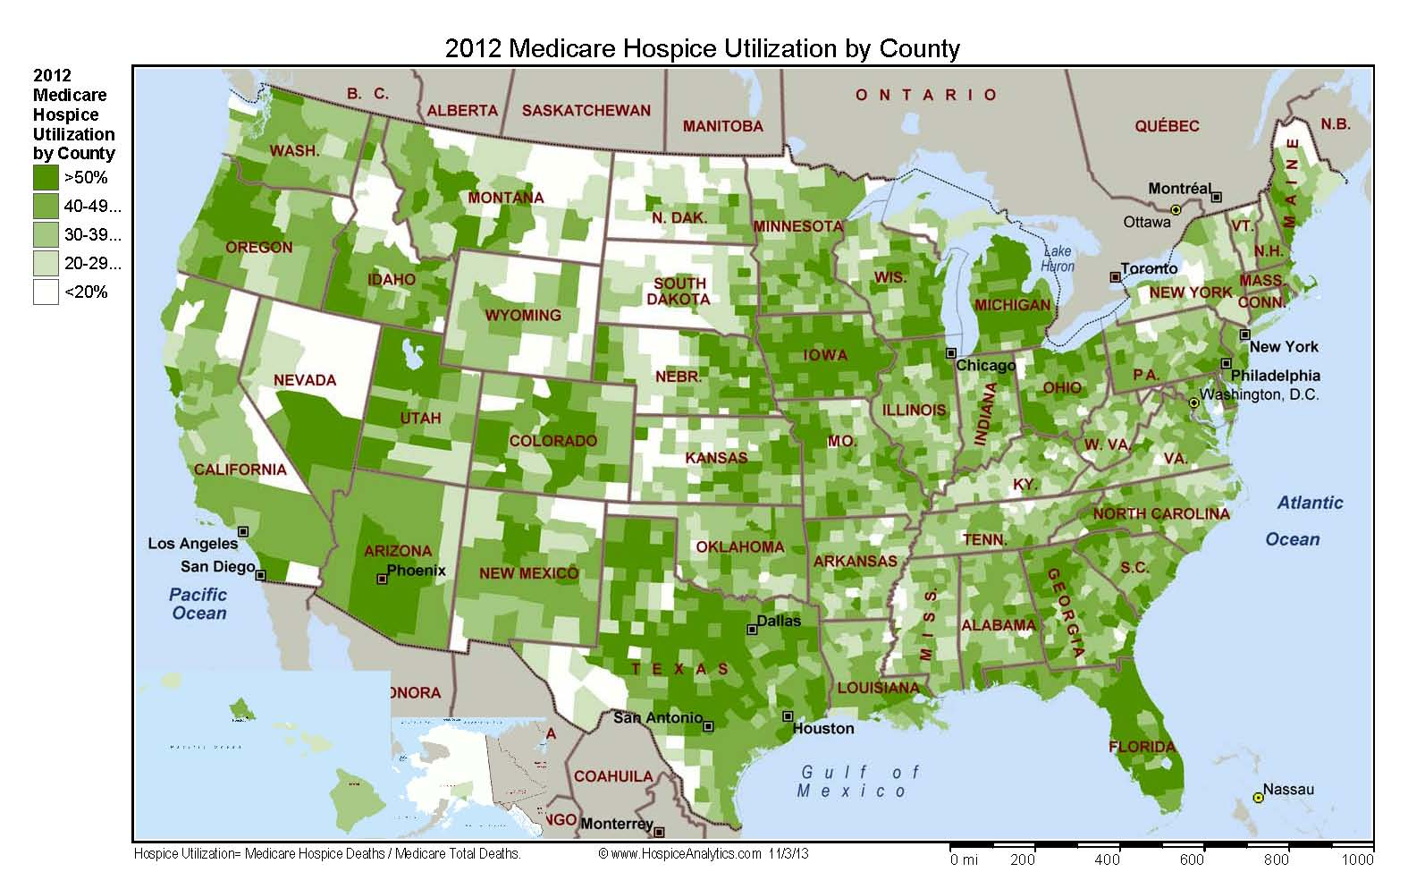

Slide 5
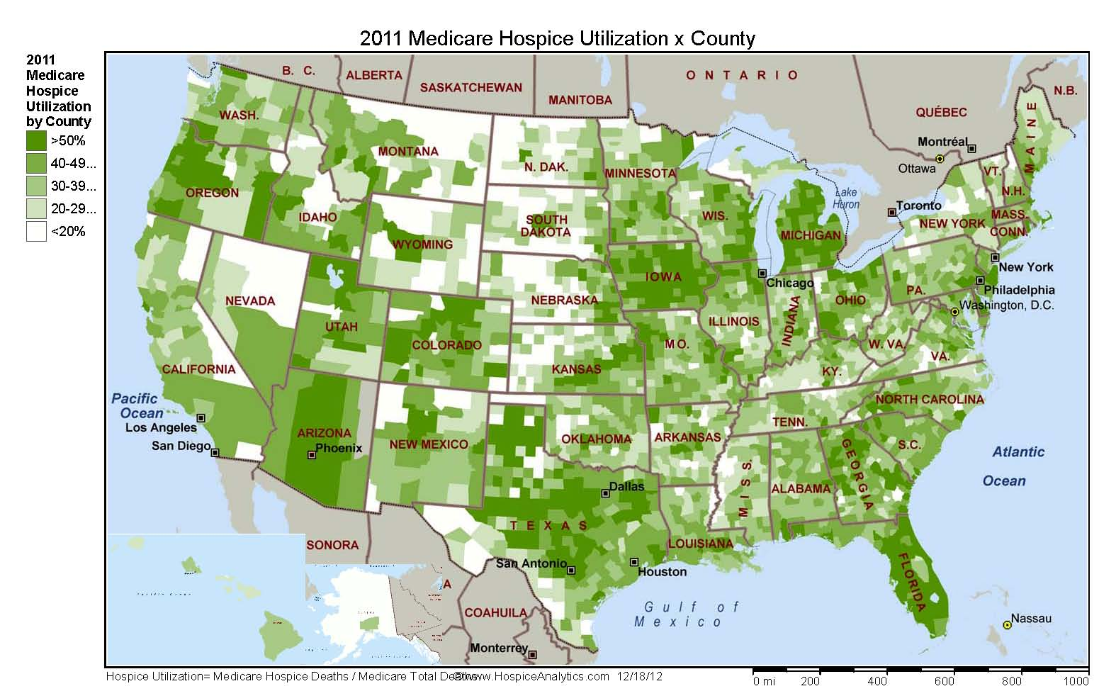

Slide 6
2012 Hospice Utilization (Medicare Hospice Deaths / Total Medicare Deaths)

Slide 7
2011 Hospice Utilization (Medicare Hospice Deaths / Total Medicare Deaths)

Slide 8
Change in Hospice Utilization 2011-2012 (Medicare Hospice Deaths / Total Medicare Deaths)

Slide 9
Thank you
Please contact Hospice Analytics with any questions, comments, feedback, or for additional information:
W: www.HospiceAnalytics.com
P: 719-209-1237
E: Info@HospiceAnalytics.com
* Review the new National Hospice Locator at www.HospiceAnalytics.com –
geo-maps and detailed information on every known hospice in the United States!

